Slide 1

SIM Tech 2009 The Tao of Web Balancing Strategy & Design for an Effective User Experience on Higher Education Web Sites
Presented by
Kati Davis (@KatiDavis)
Interactive Strategist, Stamats

Slide 2
Usability is in everything

Slide 3
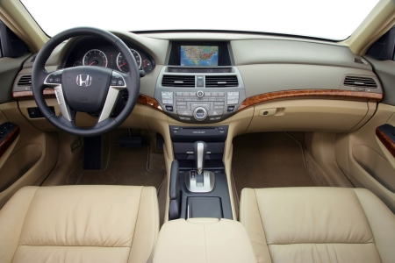

Slide 4
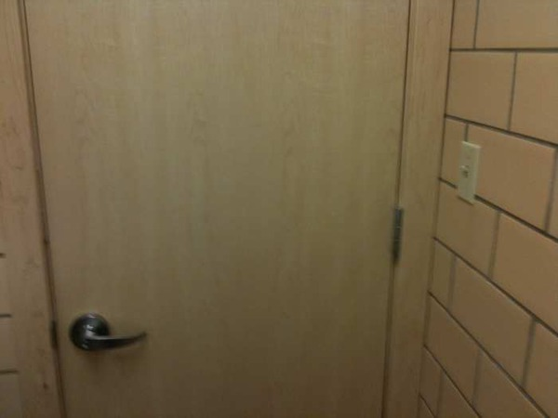

Slide 5
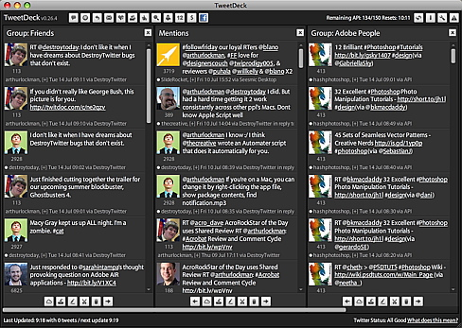

Slide 6
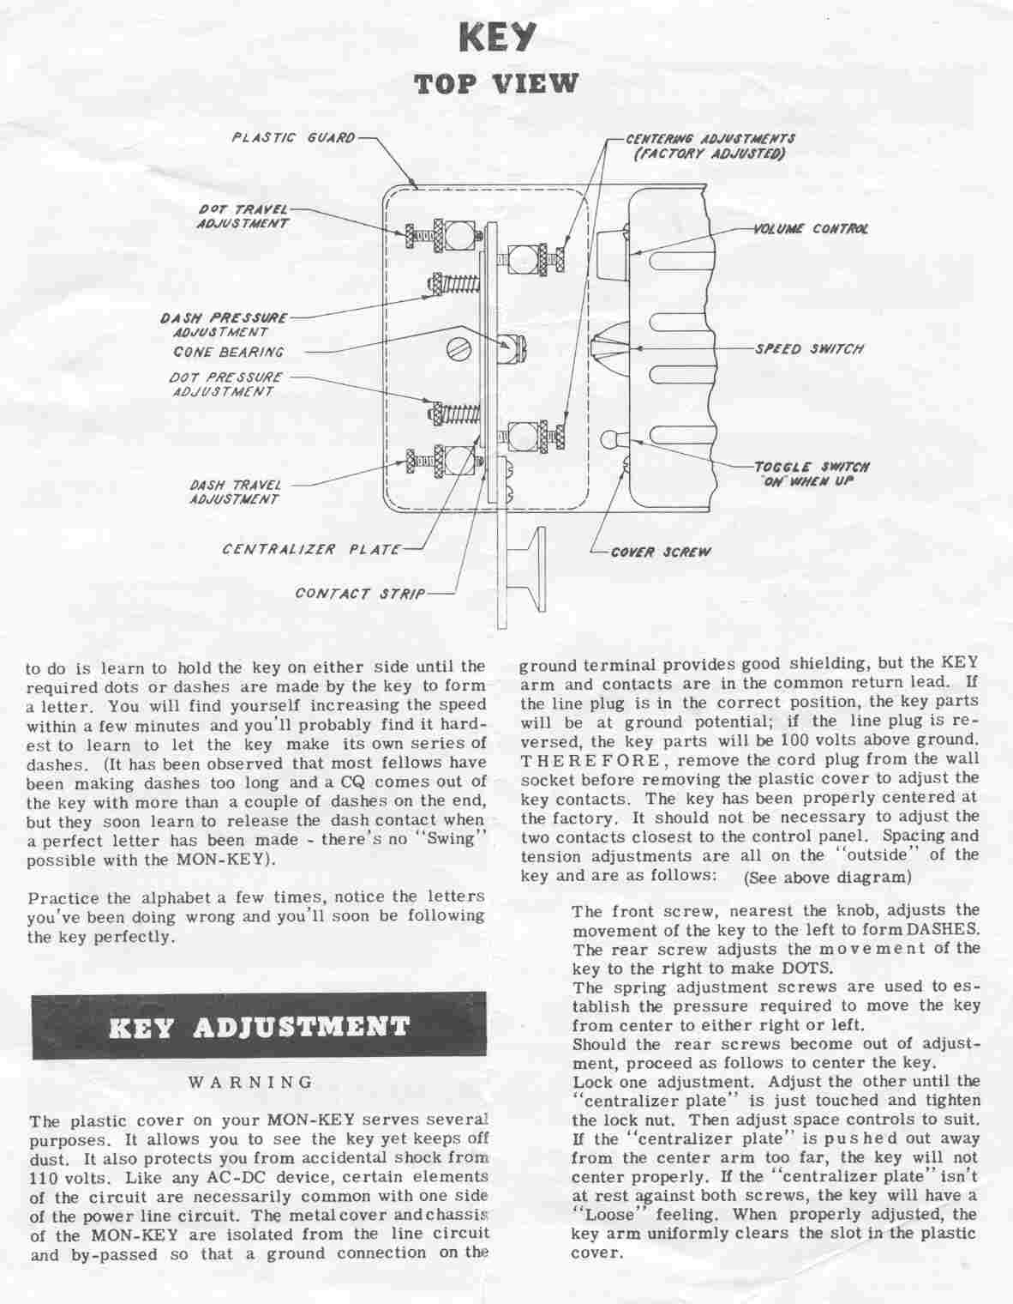


Slide 7
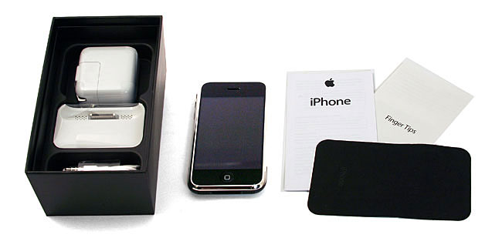

Slide 8
What is user experience design?

Slide 9
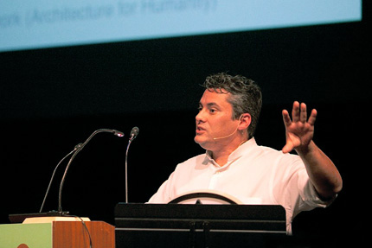
User experience design is
"an approach to creating successful experiences for people in any medium.”
- Nathan Shedroff

Slide 10

Yin and Yang represent the balance of opposites in the universe. When they are equally present, all is calm.

Slide 11






The Principles
Harmony
Transformation
Simplicity
Spontaneity
Integrity

Slide 12

Create Harmony
Working as a team
Establish balance
Contrast through font, images, etc.
Space and weight
Wireframe

Slide 13
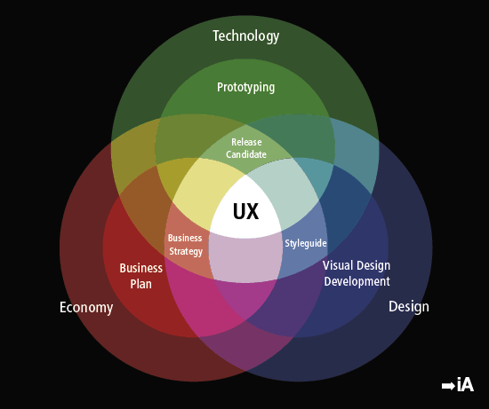
The Spectrum of User Experience
Courtesy iA Inc

Slide 14
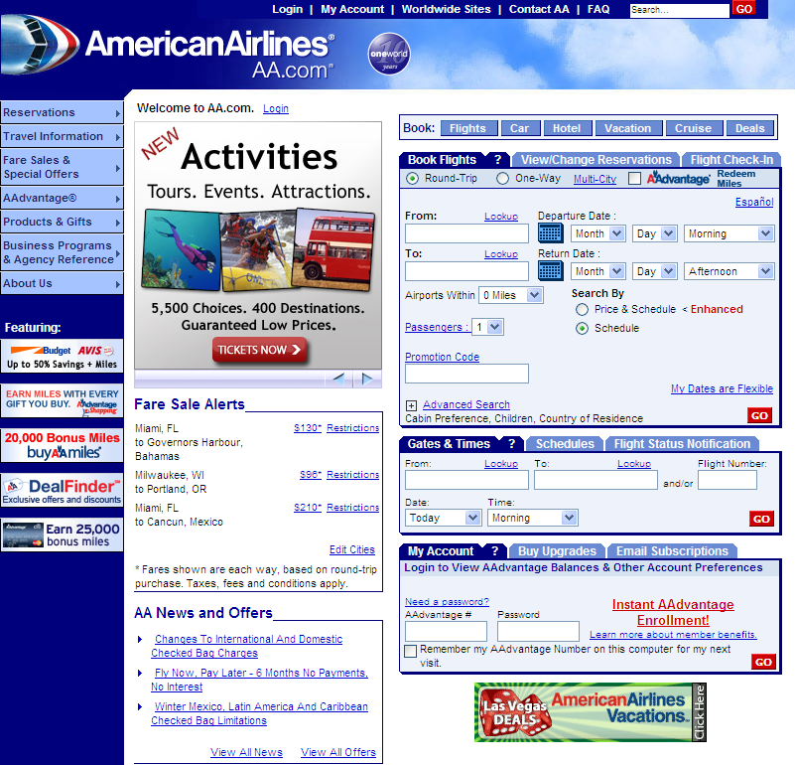

Slide 15
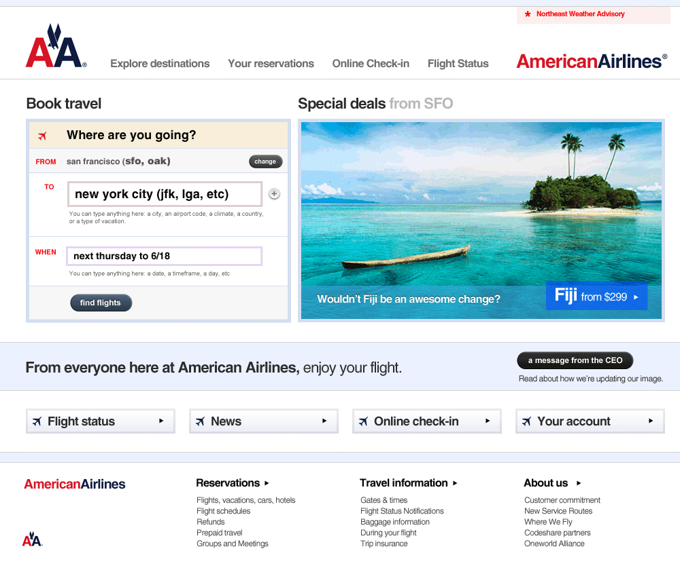

Slide 16
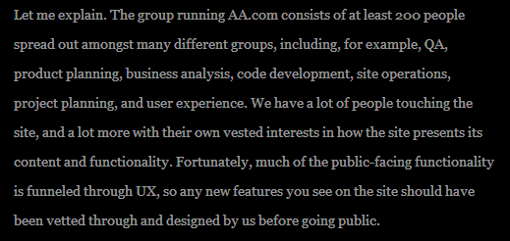

Slide 17
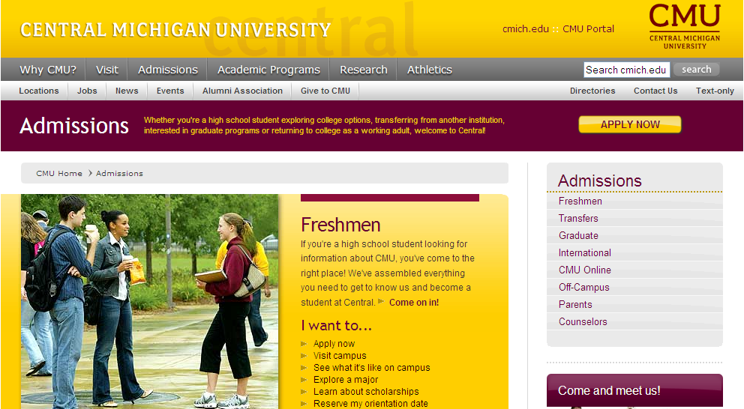
Establish Balance
Action-oriented terminology
Separation of space

Slide 18

Wireframe first
“If you fail to plan, you plan to fail”

Slide 19
Creating a wireframe
Have a site map previously developed
Determine elements needed
Assess weight, space, placement
Doesn't need to be specific for each element

Slide 20
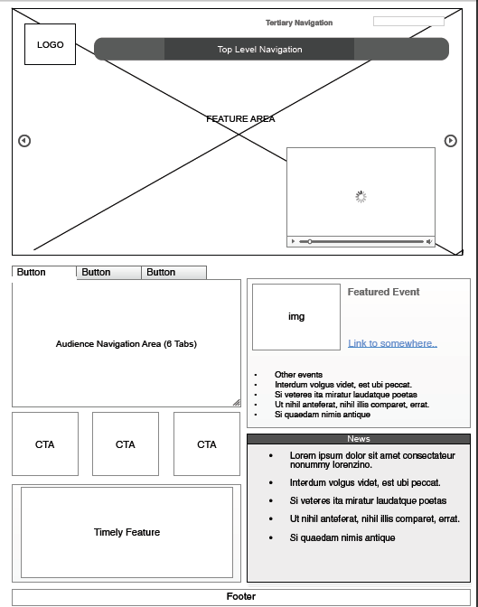

Slide 21
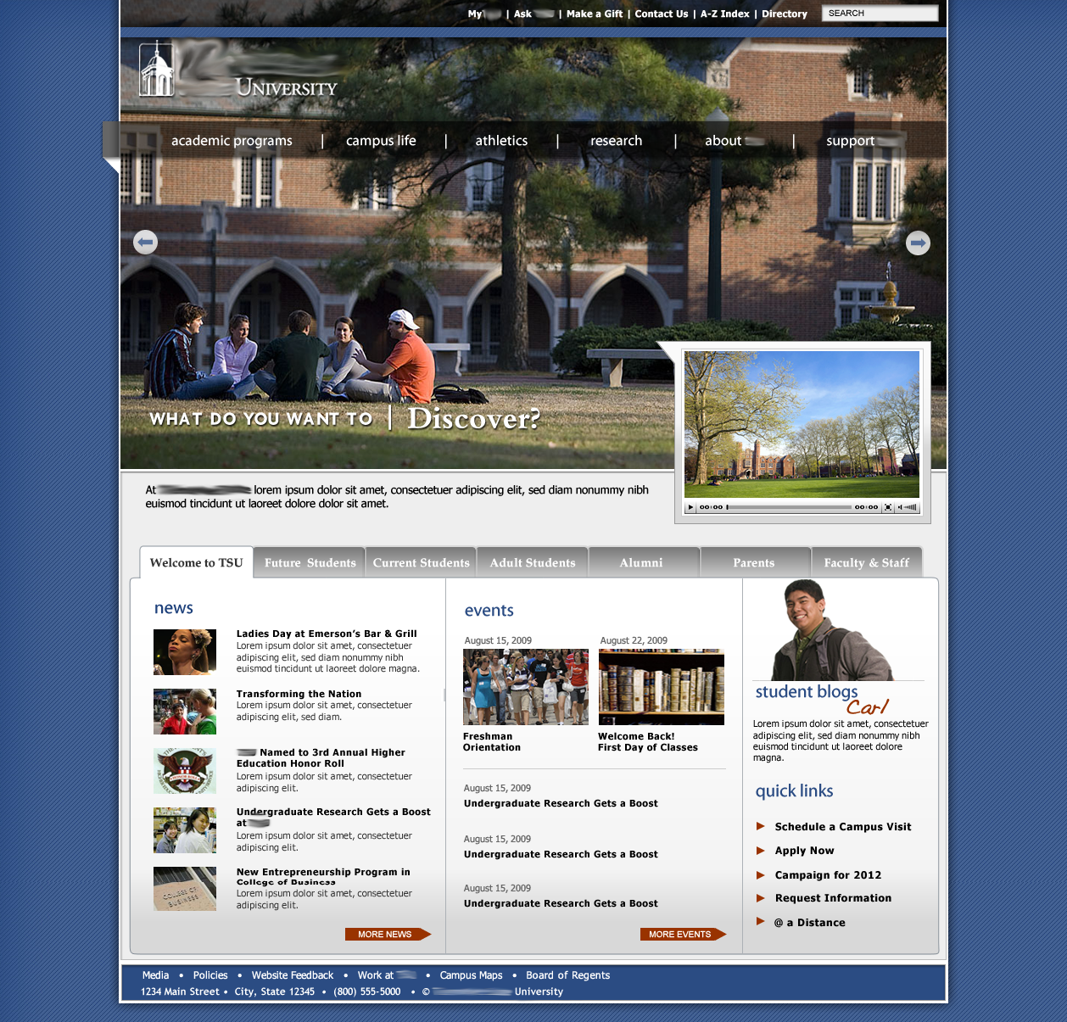

Slide 22
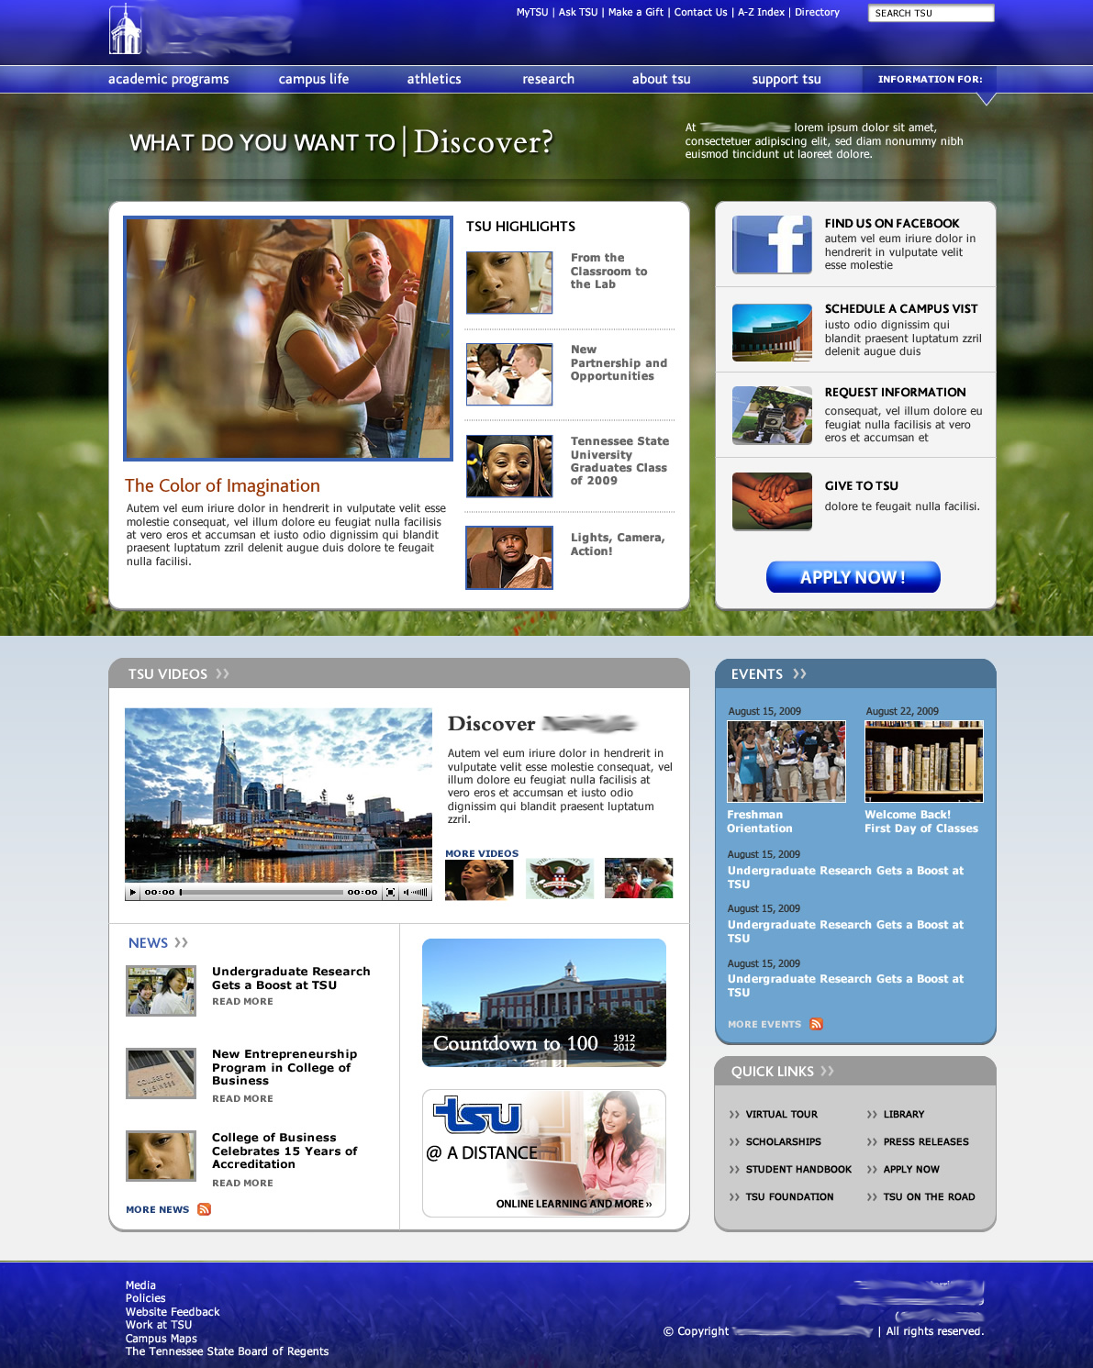

Slide 23

Transform traditional thinking
Establish consistency throughout site
Org chart isn’t navigation
Less is more
Separate internal from external

Slide 24
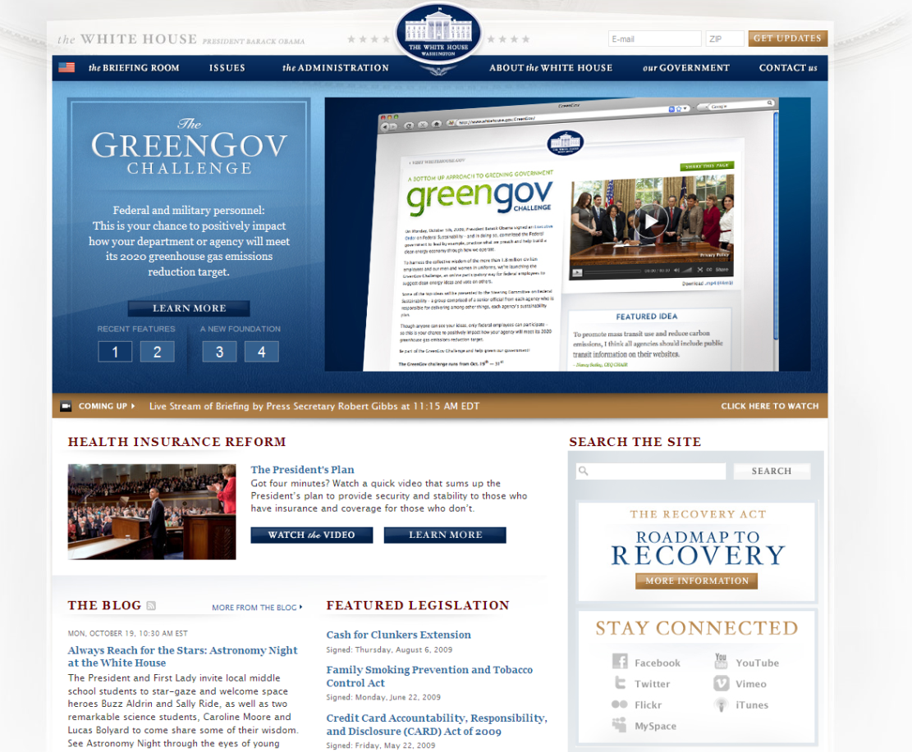
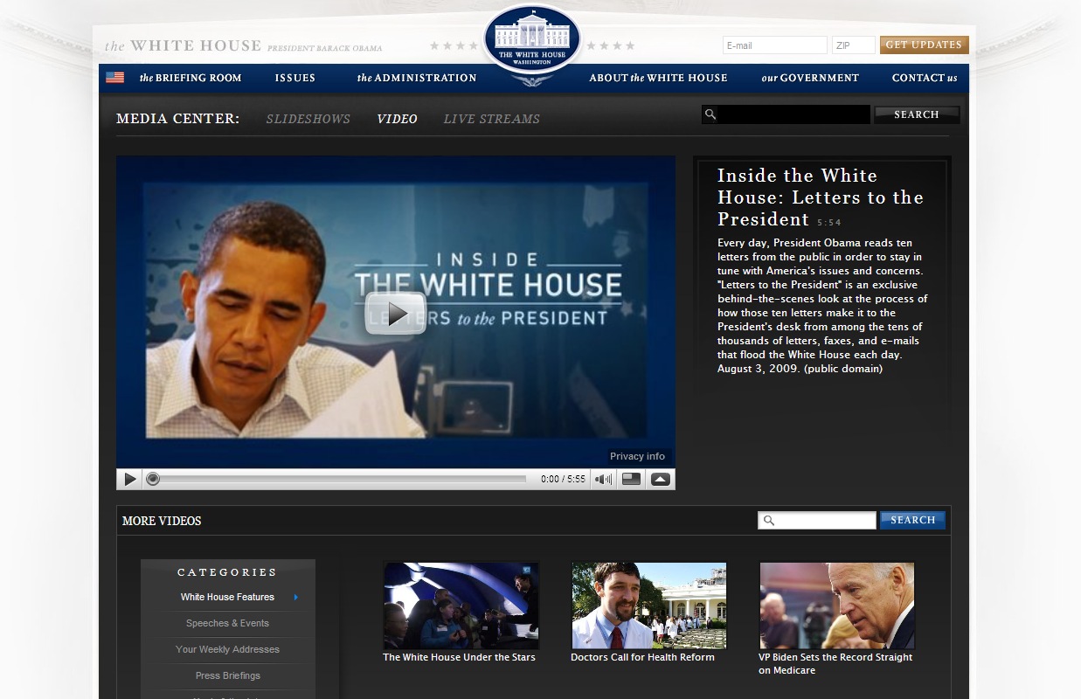
Individualize where necessary but maintain consistency

Slide 25

An organizational chart does not a navigation make.

Slide 26


Slide 27
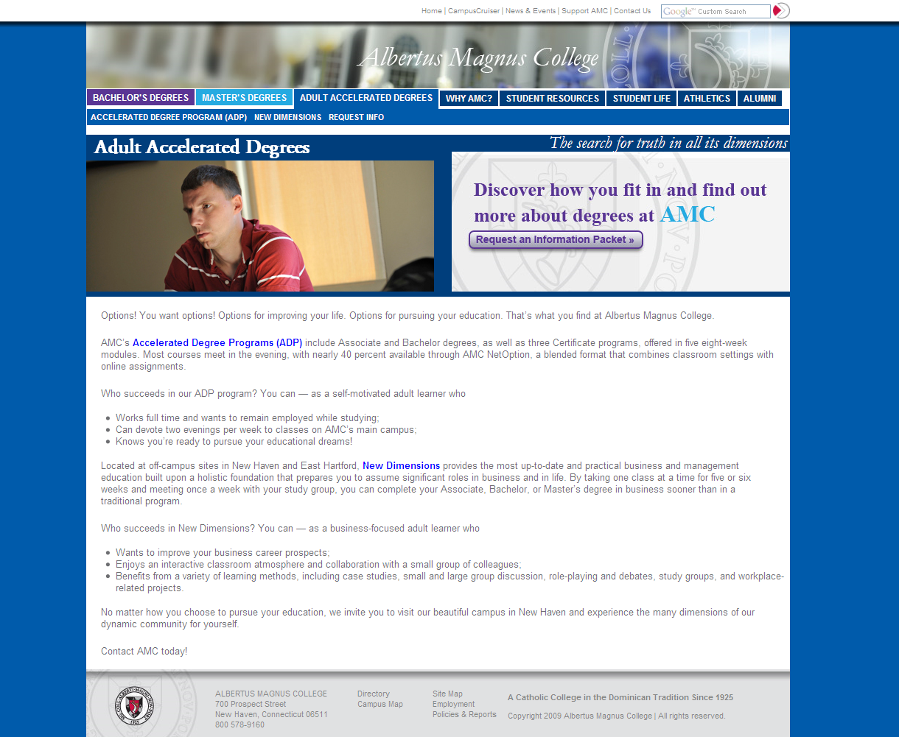


Slide 28
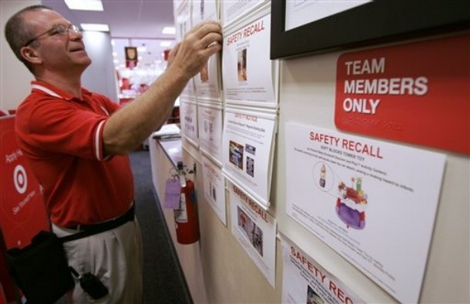
Separate internal from external content

Slide 29

Less is more
The more information on a Web site, the harder it is for the user to find what they need.

Slide 30
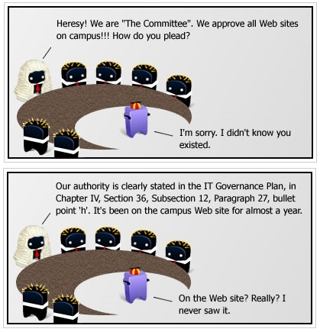
Tales from Redesignland – “Tell it to ‘The Committee’” by Tony Dunn

Slide 31

Get rid of what’s not being used
…or find a better way to present it.

Slide 32
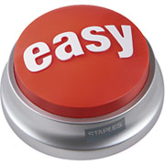
Keep It Simple Stupid
Stick to the standards
Focus on the action
Don't rely on subnavigation text
Avoid acronyms & jargon

Slide 33
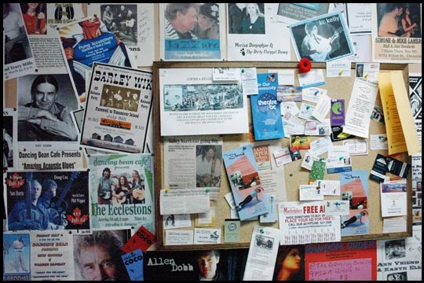
By emphasizing everything, you emphasize nothing.

Slide 34

Good calls-to-action
call attention.

Slide 35


Slide 36
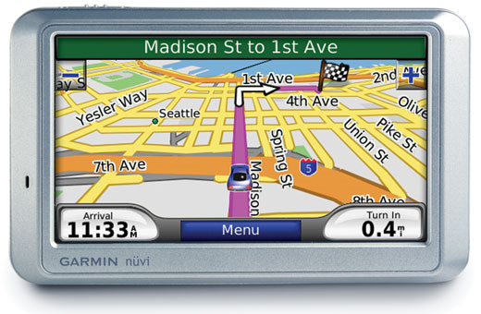
Use body area to point users in the right direction.
Use subnavigation as a backup.

Slide 37
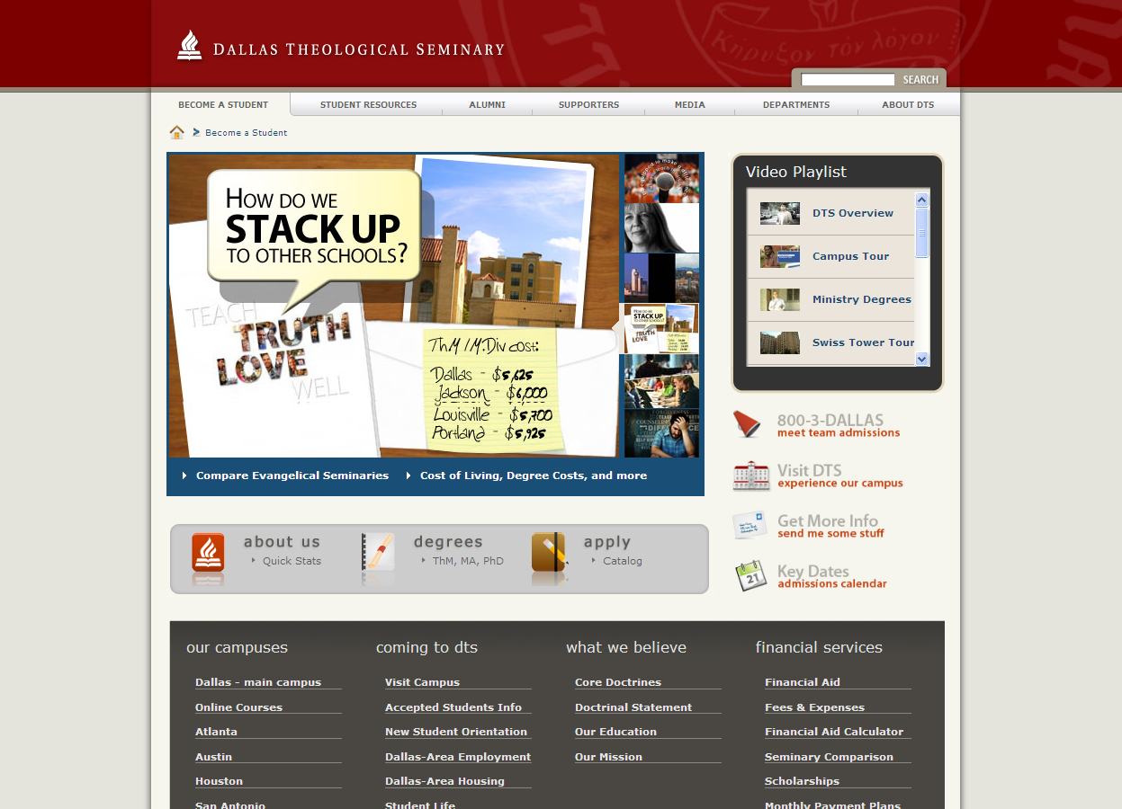

Slide 38
Which is more consumable?

Slide 39
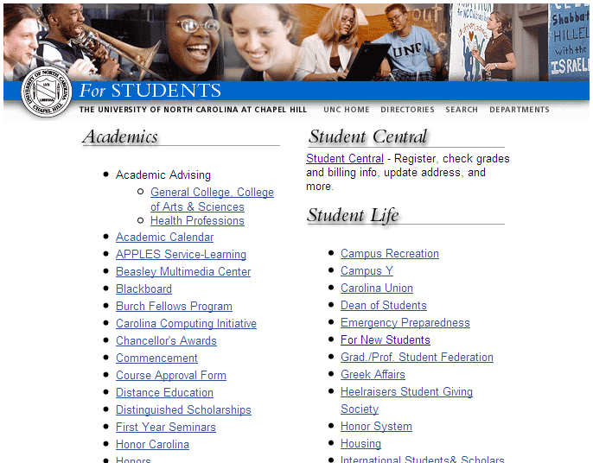

Slide 40
Or…

Slide 41
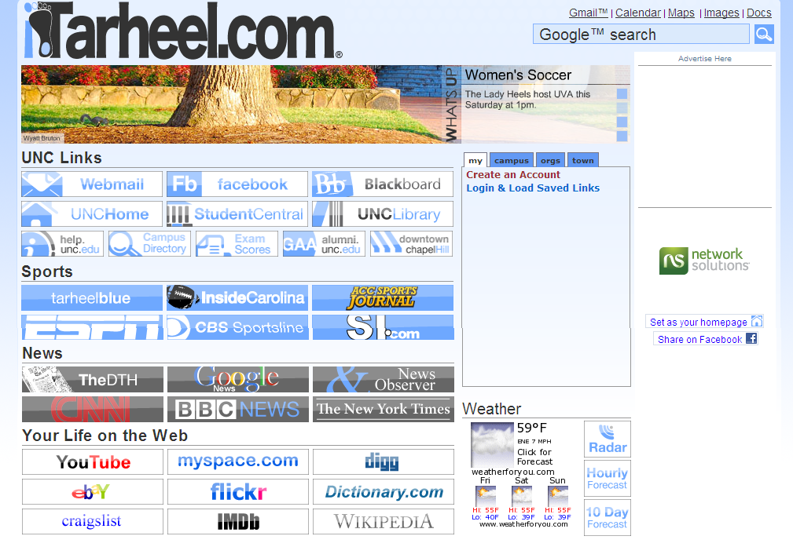

Slide 42

Jargon & Acronyms
Department/Office of… → [need]
Lifelong learning →Continuing Education
Advancement → Give or Support
Alumni Relations → Alumni
WebAdvisor, Blackboard, WebCT, etc. → [task] (i.e. register for classes, check grades or MyABC)
EPS, CE, POLS

Slide 43


Be Spontaneous
Maintain flexibility
Open communication without meetings
You can’t prepare for every decision needed

Slide 44
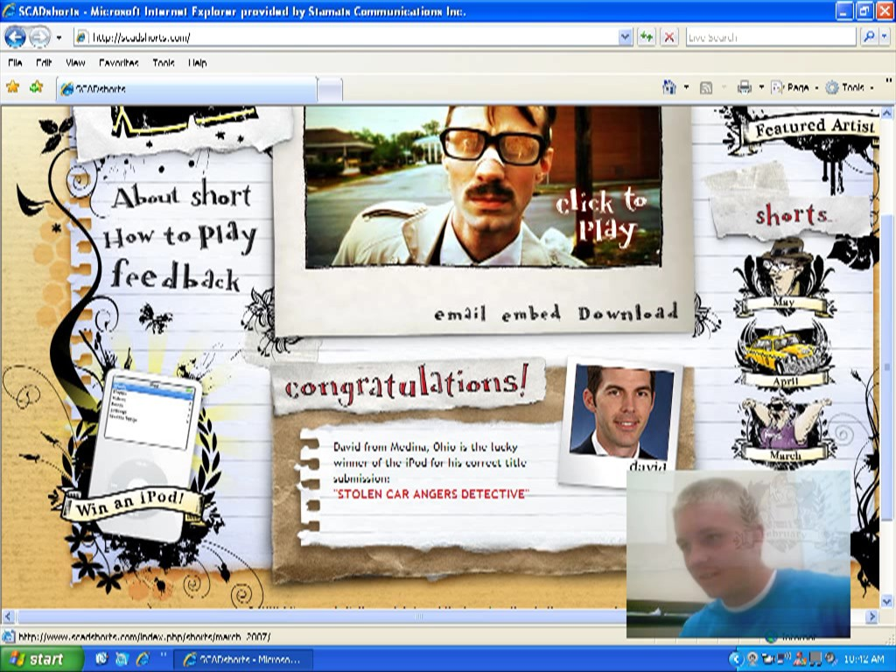
Maintain Integrity
Strategy is the first level of quality assurance
Whoever builds it will think it will work great
Test and track it

Slide 45
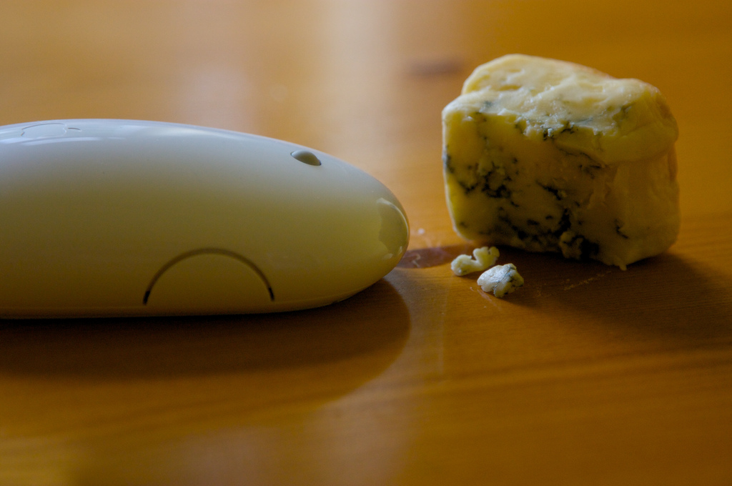
“Pay attention to what users do, not what they say.”
- Jakob Nielsen

Slide 46
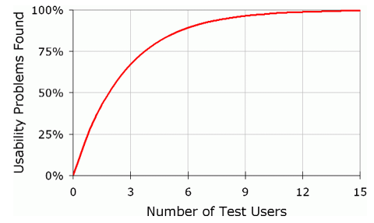
5 usability participants can reveal about 85% of all problems with your website.
Source: Jakob Nielsen’s AlertBox

Slide 47
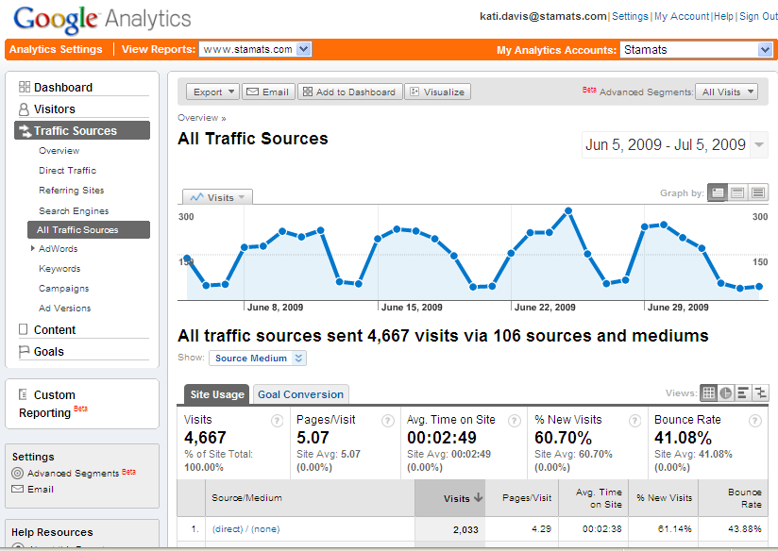

Slide 48
More tips for creating balance
Identify an action verb instead of "click here"
Use font type and size or image size and colors for weight and hierarchy
Focus on programs, majors, courses (not departments, college, schools)
Don't assume alumni are coming to donate
Avoid welcome messages - get to the tasks
Use a visited link color
Let users determine if they want to open a new window

Slide 49
Tools for creating balance
FiveSecondTest.com
Crazy Egg
Morae Usability Testing Software
Omnigraffle, Microsoft Visio, or Axure

Slide 50

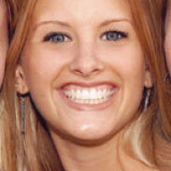
Thank You :)
Questions, ideas, comments?
Kati.Davis@Stamats.com
@KatiDavis
800-553-8878
http://www.SlideShare.net/KatiDavis

